Slide 1

React Native
ANIL JOSEPH
WA: 9833169784
Email: anil.jos@gmail.com

Slide 2
Agenda
Networking
Testing
Introduction to Mobile App Dev
Error Handling & Debugging
Publishing
Layout & Styling
State and Data Storage
Navigation
Platform Specific Code
React Native Components
React Native Fundamentals
Creating RN Applications
Native Modules
React Native Architecture
Security

Slide 3
Introduction
20+ years of experience in the industry
Technologies
C, C++
Java, Enterprise Java
.Net, .Net Core
JavaScript, Node.js
React & Angular
Mobile: React Native, Native Android, Xamarin, MAUI
GenAI and Agentic AI
Worked on numerous projects
Conducted trainings for Corporates
Anil Joseph

Slide 4
Software
Node.js & NPM
Visual Studio Code
Browsers(Chromium)
Android Studio
&
Emulator
Xcode & Simulator

Slide 5
Prerequisites
JavaScript
TypeScript
React

Slide 6
React Native
Learn Once, write anywhere

Slide 7
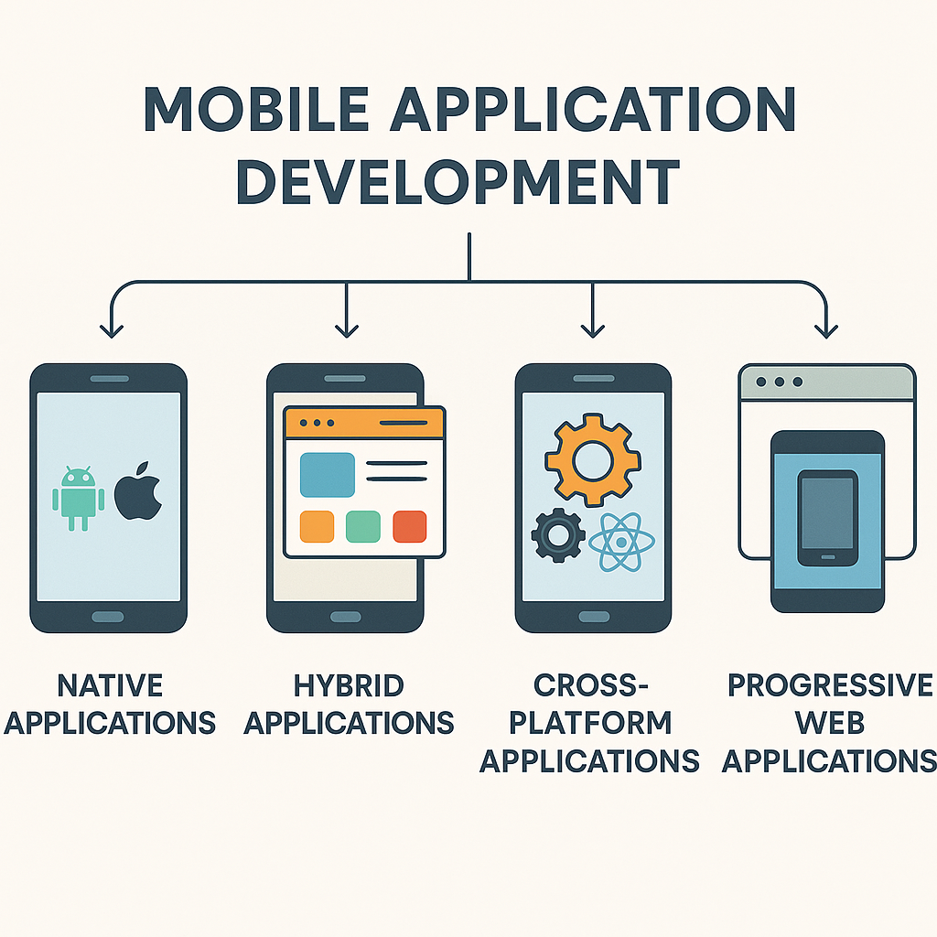
Mobile Application Development
Native Applications
Hybrid Applications
Cross-Platform Applications
Progressive Web Application

Slide 8

Native Applications
Built using platform-specific languages like iOS: Swift / Objective-C,Android: Kotlin / Java
Best performance, full access to device hardware
Usually the most expensive and time-consuming to build
Ideal for high-end apps: gaming, AR/VR, camera-heavy apps

Slide 9

Hybrid Applications
Built using web technologies (HTML, CSS, JavaScript) and wrapped in a native shell
Frameworks: Ionic, Cordova, Capacitor
Faster to build than pure native
Performance is decent, but not as smooth as fully native apps
Good for simple to medium-complexity apps

Slide 10
Cross-Platform Applications
One codebase → runs on both iOS and Android
Frameworks: React Native, Flutter, Xamarin, .NET MAUI
Almost-native performance
Saves time and cost while still giving access to device APIs
Great for most business apps, dashboards, banking apps, etc.

Slide 11
Progressive Web Apps (PWAs)
Web apps that feel like mobile apps
Installed from the browser, not the App Store
Very fast to develop and deploy
Limited access to deeper device hardware
Good for content-driven apps, e-commerce, forms, internal tools

Slide 12
React Native
A JavaScript framework that lets you build mobile apps for iOS and Android using a single codebase.
Uses native components under the hood, so apps feel fast and smooth.
Built and maintained by Meta (Facebook) with a huge open-source community.
Built on top of React.
Based on the principle of “Learn Once, Write Anywhere”

Slide 13
React Native vs. Native Apps
Factor | React Native | Native (iOS + Android)
Codebase | Single codebase for both platforms | Separate apps for iOS & Android
Development Speed | Faster — shared UI & logic | Slower — everything built twice
Performance | Very good, near-native | Best-in-class performance
Access to Device APIs | Good, sometimes requires native modules | Full access out of the box
Developer Skills | JavaScript + React | Swift/Objective-C (iOS), Kotlin/Java (Android)
Ecosystem & Libraries | Large community + plugins, sometimes unstable | Official, stable, platform-specific
Maintenance Cost | Lower | Higher
Best For | Business apps, dashboards, fintech apps, content apps | High-end games, AR/VR, animation-heavy apps

Slide 14
History
Born inside Facebook (Meta) — originally created for their internal mobile apps.
First public release: 2015, introduced at Facebook’s F8 conference.
Quickly gained popularity because it allowed JavaScript developers to build real native apps.
2016–2018: Huge ecosystem growth — community libraries, UI kits, navigation systems.
2020 onwards: Focus shifted to major improvements like New Architecture, TurboModules, Fabric Renderer, and better performance.
Today (2025), RN is one of the most widely used cross-platform frameworks across startups and enterprises.

Slide 15
Getting Started
Tools to Create React Native Applications
React Native CLI
Expo CLI

Slide 16
React Native Community CLI
Command line tools that help you build apps with react-native.
Replaces the old “react-native-cli”.

Slide 17
Getting Started: React Native CLI
Install NodeJs
Install Android Studio
Install XCode
1
Create React Native Application
2
npx @react-native-community/cli@latest init AwesomeProject
Start the Application
3
cd AwesomeProject
npm start
npm run android
npm run ios

Slide 18
React Native Framework
React Native allows developers to use the React programming paradigm to ship applications to native targets.
The React Native provides the core APIs and functionalities for application development
Creating production ready applications require more tools and libraries like
Tools for publishing the app to a store
Libraries for Navigation, Icon etc.
A React Native Framework provides the tools and libraries.
Expo is a Open Source React Native Framework.

Slide 19
Expo
Expo is a framework and a set of tools that sits on top of React Native to make mobile development easier.
It handles a lot of the native setup for you — so you can focus on writing JavaScript/TypeScript.
Expo SDK, a powerful SDK: camera, sensors, notifications, secure storage, location, permissions… all without writing native code.
Works on all platforms: iOS, Android, and Web (with Expo Web).
You can run your app instantly on your phone using Expo Go, without compiling native code.

Slide 20
Getting Started: Expo CLI
Install NodeJs
Install Android Studio(optional)
Install Xcode(optional)
1
Create React Native Application
2
npx create-expo-app@latest
Start the Application
3
cd app-name
npm start
Use –template option to choose a template
npm start

Slide 21
Expo Builds
Managed Workflows
Write JavaScript/TypeScript → Expo takes care of all the native stuff.
No need of XCode or Android Studio(unless you want to use the Emulator or Simulator)
Development Builds
More powerful and more flexible.
Can include Native modules
Integrate deeper native libraries (e.g., biometrics, encryption, payment SDKs)
Start with a managed workflow and move to a development build

Slide 22
Expo Application
app.json
The main configuration file for an Expo project.
Controls how your app looks, behaves, and builds on iOS, Android, and the web.
Expo reads this file every time you run or build the app.
Configure :
App name & icon, Splash scree, App version, Permissions etc.
index.js
Start script of the application.
Registers the root component to the AppRegistry.
AppRegistry
React Native’s entry point that tells the native OS which component should start the app.

Slide 23
React Native Application Code – Big Picture
A React Native app is still just a React app
Components, props, state, hooks – all the same ideas
The main difference is:
UI is not rendered to the DOM (<div>, <span>)
It is rendered to native UI components (<View>, <Text>, etc.)
Styling is done via JavaScript objects, not CSS files
Navigation, gestures, animations, platform APIs are all handled by libraries

Slide 24
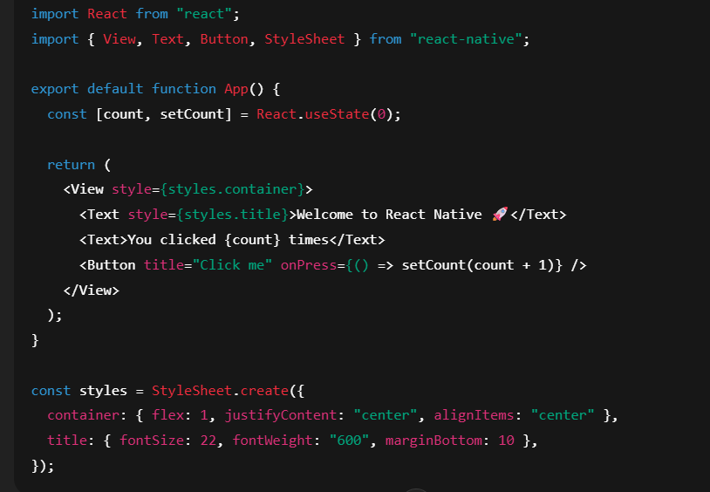
A Simple React Native Screen (Expo App)

Slide 25
React (Web) vs React Native – Mental Mapping
JSX Elements
Web:
<div>, <span>, <p>, <img>, <button>
React Native:
<View>, <Text>, <Image>, <Pressable>, <TouchableOpacity>, <ScrollView>
Styling
Web:
CSS files, CSS Modules, styled-components, Tailwind, className
React Native:
StyleSheet.create({ ... }) or inline JS objects
No CSS selectors, no id, no .class

Slide 26
React (Web) vs React Native – Mental Mapping
Platform
Web:: Renders to DOM in the browser
React Native: Renders to native views via the RN bridge / new architecture
Your JS runs in a JS engine, UI is 100% native
Hooks / State / Props
Same concepts as React web:
useState, useEffect, useContext, useMemo, useCallback, custom hooks
React developers can basically bring over their state management patterns unchanged:
Redux, Zustand, MobX, React Query, etc.

Slide 27
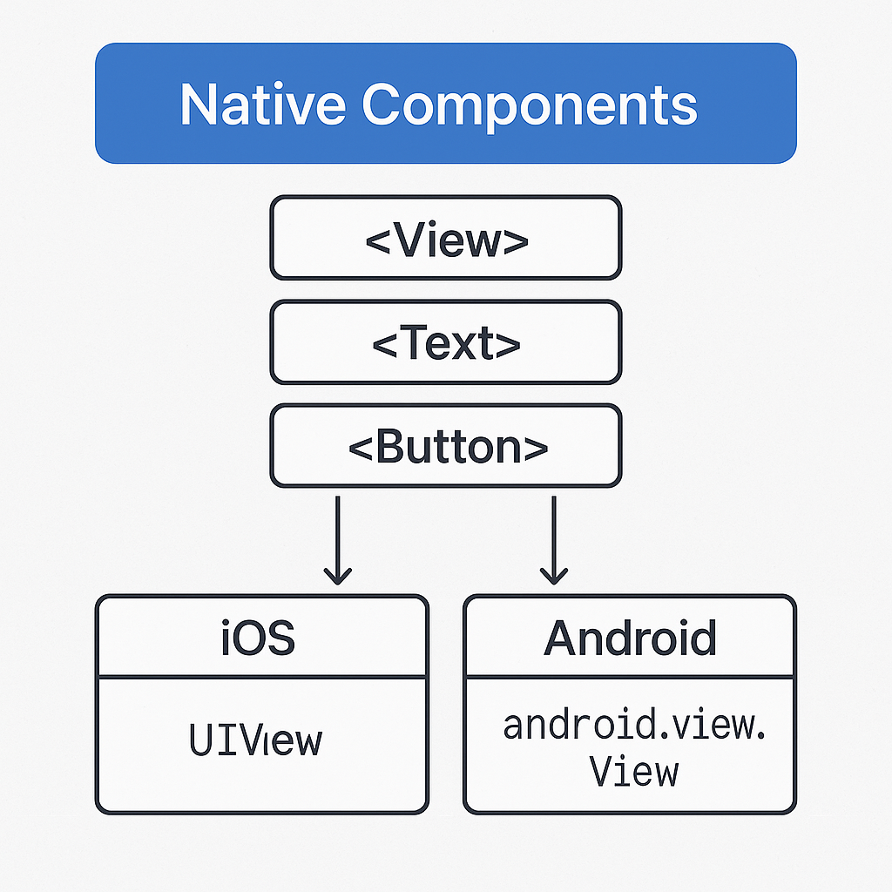
Native Components
In Android, views are written in Kotlin/Java; in iOS, they’re written in Swift/Objective-C.
With React Native, you use JavaScript + React components to invoke those native views.
At runtime, React Native creates the actual Android/iOS views behind the scenes.
Since RN components use the same underlying native UI elements, apps look, feel, and perform like truly native apps.
These platform-backed elements are called Native Components.

Slide 28
Core Components
React Native provides a set of built-in, ready-to-use Native called Core Components.
React Native has many Core Components for everything from controls to activity indicators.

Slide 29
Core Components
Basic Components
List View
View, Text, TextInput, ScrollView, Image, Pressable, etc
FlatList, SectionList
Android
BackHandler, ToastAndroid etc.
iOS
ActionSheetIOS
Others
Alert, Dimensions etc.
User Interface
Button, Switch

Slide 30
View
View is the most fundamental component for building a UI
View is a container
View supports layout with Flexbox
Supports Touch Events
Its maps directly to the native equivalent: UIView or android.view

Slide 31
Flexbox
A layout system that helps you arrange elements on the screen
Controls how items align, space themselves, and wrap
Default layout mechanism in React Native.
Flexbox
flex – how much space an element should take
flexDirection – row or column layout
justifyContent – vertical alignment (in a column)
alignItems – horizontal alignment
flexWrap – wrap items to next line

Slide 32
Navigation
Just like on the web, apps need to move between screens
React Native uses navigation libraries to manage screens, routes, stacks, tabs, and drawers
The most popular library is React Navigation
Expo provides Expo Navigation based on React Navigation

Slide 33
React Navigation: Native Stack Navigation
Stack Navigator provides a way for your app to transition between screens where each new screen is placed on top of a stack.
This navigator uses the native APIs UINavigationController on iOS and Fragment on Android
Supports a Static and Dynamic Configuration

Slide 34
React Navigation: Bottom Tabs
A simple tab bar on the bottom of the screen that lets you switch between different routes.
Routes are lazily initialized -- their screen components are not mounted until they are first focused.

Slide 35
Vector Icons
Icons created using mathematical paths, not pixels
Libraries like react-native-vector-icons, Expo Vector Icons provide these icons
Scalable, Lightweight, Consistent Look
Large Icon set
Easy to use

Slide 36
ScrollView
A container that lets content scroll
Renders all its children at once
Best for small, static, or short content
Simple and easy to use

Slide 37
Touchable & Pressable
Components used to make things touchable / clickable in mobile apps.
They can wrap any element (text, image, view) and give it tap, press, and feedback behavior.
Touchable
TouchableOpacity → reduces opacity on press
TouchableHighlight → adds a highlight background
TouchableWithoutFeedback → no visual feedback
TouchableNativeFeedback (Android only)
Pressable

Slide 38
Pressable
Most flexible touch component
Full control over:
onPress, onLongPress, onPressIn, onPressOut, disabled states
Style can change based on press state

Slide 39
Virtualized Lists
Lists that render only the items currently visible on the screen.
Instead of drawing all items at once, they load/unload items as you scroll
Makes long lists fast + memory-efficient
Provided by FlatList, SectionList, and VirtualizedList
Advantages
High performance, Low memory usage, Easy to Use

Slide 40
FlatList: Optimizations
Stable keyExtractor (no index keys)
Memoized row components (React.memo)
useCallback for renderItem & callbacks
getItemLayout for fixed-height rows
Tune initialNumToRender, maxToRenderPerBatch, windowSize
Use pagination with onEndReached
Avoid nested virtualized lists

Slide 41
SectionList
A virtualized list like FlatList, but with grouped sections
Each section has:A header (e.g. “A”, “B”, “Fruits”, “Veggies”)An array of data itemsPerfect for grouped / categorized lists

Slide 42
Navigation Patterns
Stack Navigation
Screens on top of each other (like browser history)
Perfect for “go to details” flows
Tab Navigation
Bottom or Top tabs to switch between major sections
Ideal for social apps, shopping apps, dashboards
Drawer Navigation
Slide-in menu from left side
Good for apps with many sections or settings

Slide 43
Networking
Applications need to communicate to the backend services.
React Native supports HTTP and WebSocket protocols based communications
HTTP calls
React Native’s JavaScript supports both fetch API’s and the XMLHttpRequest object.
XMLHttpRequest based API like axios, firsbee etc. can be used.
WebSockets
React Native also supports WebSockets, a protocol which provides full-duplex communication channels over a single TCP connection.

Slide 44
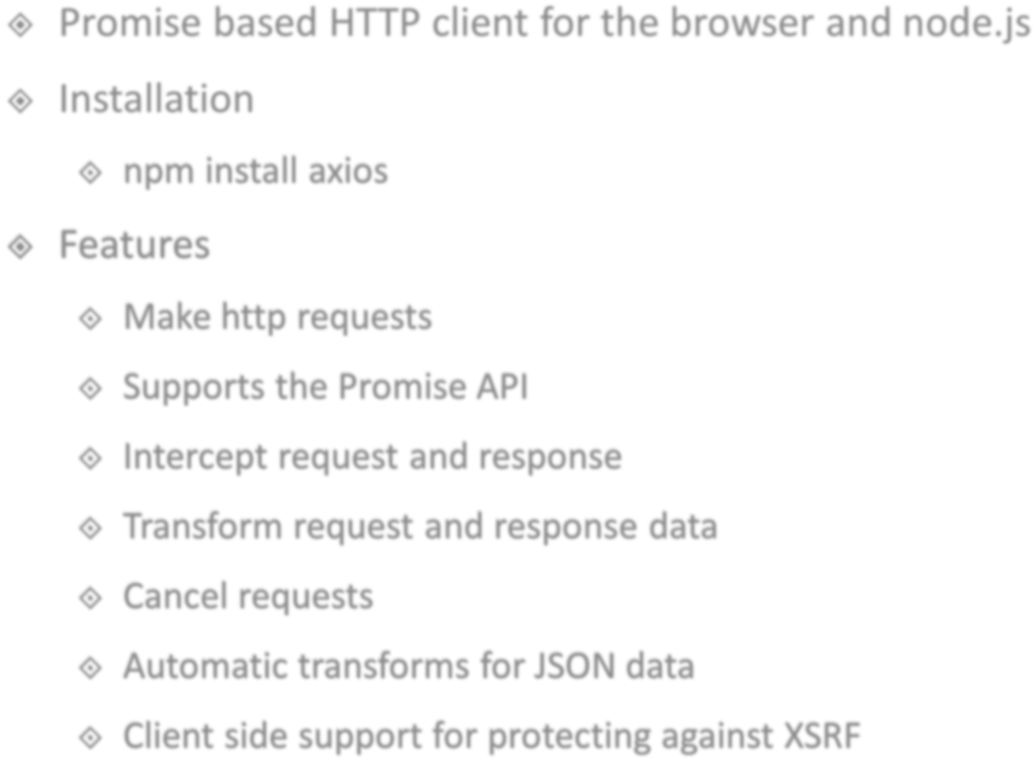

















Slide 45





axios.request({config}) axios.get(url, {config}) axios.post(url,{data}, {config}) axios.delete(url, {config}) axios.put(url,{data}, {config})

Slide 46











Base URL
axios.defaults.baseURL = 'https://abc.com’;
Headers
axios.defaults.headers.common['Authentication'] = AUTH_TOKEN;
Headers for specific methods
axios.defaults.headers.post['Content-Type'] = 'application/json';

Slide 47
Navigations
Navigation is provided by a community solution.
React Navigation is a standalone library that allows developers to set up the screens of an app with navigation.
Supports various types of navigation
Standard Stack Navigation
Drawer Navigation
Tab Navigation
https://reactnavigation.org/

Slide 48
List Views
React Native provides a suite of components for presenting lists of data.
The two main components are
FlatList
SectionList

Slide 49
FlatList
A performant interface for rendering basic, flat lists, supporting the most handy features
Fully cross-platform.
Optional horizontal mode.
Configurable viewability callbacks.
Header support.
Footer support.
Separator support.
Pull to Refresh.
Scroll loading.
ScrollToIndex support.
Multiple column support.

Slide 50
Section List
A performant interface for rendering sectioned lists, supporting the most handy features
Fully cross-platform.
Configurable viewability callbacks.
List header support.
List footer support.
Item separator support.
Section header support.
Section separator support.
Heterogeneous data and item rendering support.
Pull to Refresh.
Scroll loading.

Slide 51
Component API’s
Alert
Launches the Alert dialog with the specified title, message and actions.
Dimensions
Gets the dimensions(height & width) of the screen, window and notifies changes to the dimensions.
Linking
Linking provides an interface to interact with incoming and outgoing messages.
Keyboard
Keyboard module to control keyboard events.

Slide 52
Community Packages
AsyncStorage
NetInfo
Geolocation
Icons
Camera
Share

Slide 53
Platform Independent Code
React Natives Provides 2 ways to write platform-independent code
Using the Platform Module
Using Platform specific file extensions

Slide 54
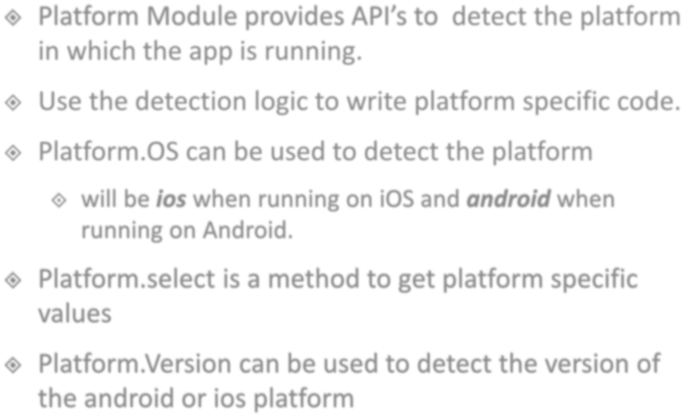























Slide 55

















Slide 56
Data Storage Options
In Memory
Redux and React Context
Persistent
Async Storage, SQL-lite Database
Secure Storage
iOS - Keychain Services
Android - Secure Shared Preferences
File System
Sandboxed locations: Documents and cache
Database Services
Firebase

Slide 57
Async Storage
The most common storage for small amounts of data
Works like localStorage in web
Stores strings only(Key-Value pairs)
Good for settings, flags, tokens (non-sensitive), preferences

Slide 58
Secure Storage
A secure, encrypted key–value store used to save sensitive data on the device.
Use the Expo SecureStore library
Uses iOS Keychain
Uses Android Keystore + EncryptedSharedPreferences
Store sensitive information like: JWT Access/Refresh Token, passwords, API Keys,

Slide 59
Secure Storage Advantages
iOS (Keychain)
AES-256 hardware-backed encryption
Keys stored in Secure Enclave (when available)
Protected by device passcode/FaceID/TouchID
Android (Keystore)
AES-256-GCM encryption
Keys generated & stored in Trusted Execution Environment
Data stored in EncryptedSharedPreferences

Slide 60
SQL Lite
SQLite is a lightweight, embedded relational database stored directly on the device.
It supports SQL queries, tables, indexes, joins
Libraires
expo-sqlite (Expo)
react-native-sqlite-storage
Ideal when your app needs structured, persistent, queryable data.
Use-cases
Offline-first applications
Local caching

Slide 61
File System
React Native doesn’t give you direct access to the OS file system.
Instead, you use a library:
Expo apps → expo-file-system
RN CLI apps → react-native-fs (or also expo-file-system if using Expo modules)
Provides access the app sandboxed folders
documentDirectory – persistent, for your app’s files
cacheDirectory – temporary, OS/app may clear it
Store PDF’s, Images etc.

Slide 62
React Native Architecture
React Native has evolved over time and the architecture has changed for better performance.
The new architecture was introduced in 2018 and by 2022(RN version 0.68) was available as on opt-in feature. By 2024(RN version 0.73) it’s the default architecture
Features of the New Architecture
JSI(JavaScript Interface)
Fabric Renderer
TurboModules
Unified C++ core
Codegen (Automatic Native Code Generation)
Improved Multithreading

Slide 63
JSI (JavaScript Interface)
JSI is a lightweight, high-performance C++ interface that lets JavaScript call native code directly, without using the old asynchronous Bridge.
A new low-level connector that replaces the Bridge, enabling React Native’s New Architecture to be fast, modern, and concurrent.
Enables synchronous, low-latency communication between JS and Native.
No JSON Serialization, event queues, bridge batching.
Faster, Lower memory,

Slide 64
Fabric
A modern, concurrent, and performant UI rendering system.
Key Features
Concurrent React support → non-blocking UI updates.
Improved layout and diffing, using C++ core.
Better memory management.
Synchronous rendering where needed (critical UI updates).
Partial tree updates instead of re-rendering the entire tree.
Better support for large lists.

Slide 65
Shadow Tree
The Shadow Tree is React Native Fabric’s in-memory representation of your UI, similar in concept to the Virtual DOM.
It holds Shadow Nodes for every component and is responsible for layout, diffing, and computing native view mutations before committing them to the screen.

Slide 66
Shadow Tree
Old Architecture | New Architecture (Fabric)
No Shadow Tree—UIManager processed JSON command batches from JS | Maintains a Shadow Tree and computes minimal native mutations
Updates sent through async Bridge, serialized as JSON | No Bridge, no JSON—direct C++ calls via Fabric
Layout partly JS-driven, partly native | Full layout in C++, always consistent
Whole view updates often required | Partial tree updates, only changed nodes mutated
Dependent on JS thread responsiveness | Many UI updates happen independent of JS

Slide 67
Yoga
Yoga is a cross-platform layout engine, written in C++, that implements Flexbox to calculate size and position for all React Native components.
It ensures that layout behaves the same way on iOS, Android, and Web, regardless of platform differences.
Features
Implements Flexbox
Cross-platform + Deterministic
Used by Fabric (and used to be used by UIManager)
Fast and Lightweight(C++)

Slide 68
Threads in React Native
JS Thread
Runs JavaScript (React logic, state updates, effects, reconciler).
Native Main Thread (UI Thread)
Renders the actual UI (UIKit on iOS, Views on Android).
Fabric “Shadow Tree / Layout” Thread (C++ Core)
Hosts the Shadow Tree (virtual UI tree).
Runs Yoga layout in C++.
Performs diffing, committing, and generating native mutations.
JSI Runtime Thread(s)
Handles low-level JS <-> C++ bindings.

Slide 69
Concurrent React support
Fabric fully supports Concurrent React, allowing rendering work to be paused, resumed, or reprioritized without freezing the UI.
This keeps interactions smooth even during expensive state updates or long renders.

Slide 70
Synchronous Rendering (in Fabric)
n the New Architecture, certain UI updates—especially those involving direct user interaction—can be applied immediately on the native thread, without waiting for the JS thread, React reconciliation, or asynchronous scheduling.

Slide 71
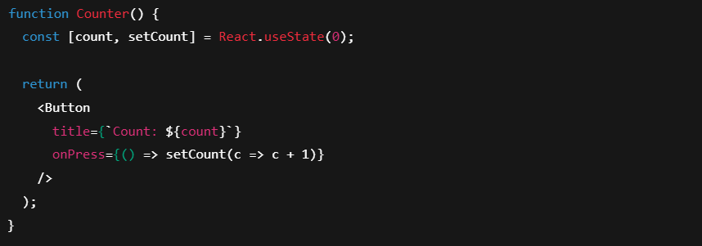
JSI: Code

Slide 72
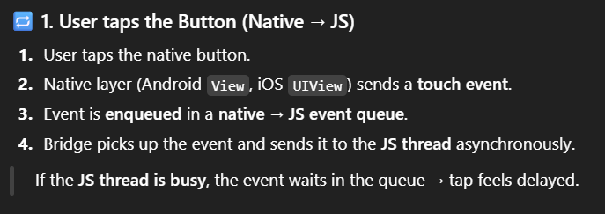
Old Architecture

Slide 73
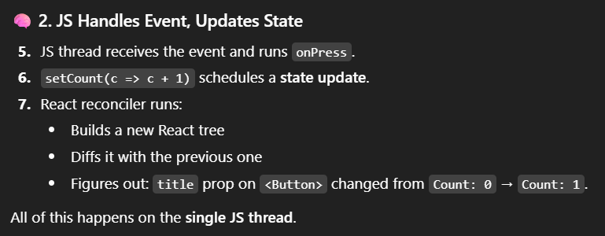
Old Architecture

Slide 74
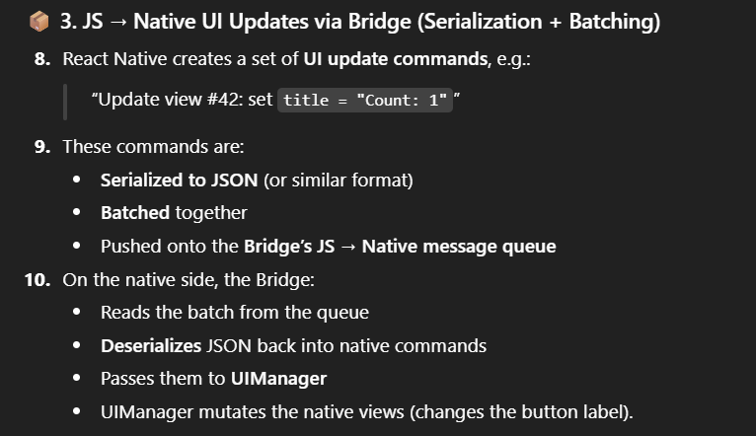
Old Architecture

Slide 75
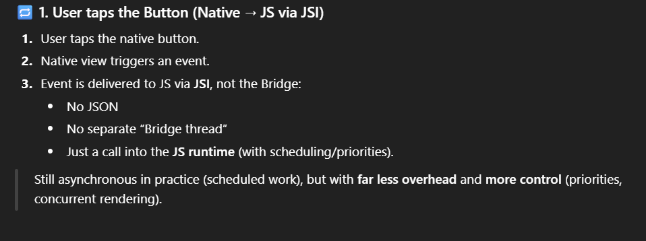
New Architecture

Slide 76
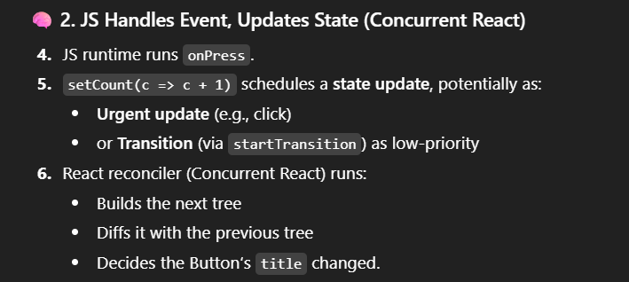
New Architecture

Slide 77
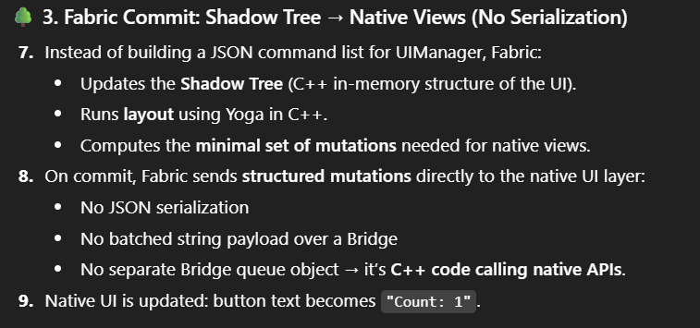
New Architecture

Slide 78
Turbo Modules
Next-generation native modules in React Native that replace the old “Native Modules” system.
They use JSI (JavaScript Interface) for direct JS ↔ native calls, removing the Bridge and enabling faster, type-safe, lazy-loaded native functionality.
Direct Calls via JSI (No Bridge)
Lazy Loading
Codegen for Type Safety
Multithreaded + High Performance
Can be developed in multiple languages: Swift, Kotlin, Java, Objective-C, or C++.

Slide 79
Expo Modules
Expo Modules are a modern, developer-friendly system for creating native functionality in React Native
Developed using Swift, Kotlin, and TypeScript, without dealing with complex C++ or low-level JSI bindings.
They provide a clean API layer on top of iOS and Android native code while remaining fully compatible with the React Native New Architecture.

Slide 80
Expo Modules Advantages
Add native features quickly with minimal boilerplate
Access OS APIs (sensors, hardware features, device info)
Avoid writing C++ or JSI code manually
Maintain compatibility with Expo toolchains

Slide 81












Redux is an open-source JavaScript library designed for managing application state.
It is primarily used together with React or
Angular for building user interfaces.
Redux was built on top of functional programming concepts.

Slide 82

Why Redux?
State
App
State
Users
Customers
Auth
Dashboard
Managing Complex State can be difficult
List
Edit

Slide 83
Why Redux?
Global State
App
Users
Customers
Auth
Dashboard
List
Edit

Slide 84
Redux Flow
Receives Action & Updates State
Action
Reducer
Predefined Information
Updates
Stores Application Data
Dispatches
Central Store
Manipulates Application Data
Triggers
Passes updated State to component
Subscribes
Component
Subscription

Slide 85
Redux Flow
Receives Action & Updates State
Action
Middleware
Reducer
Predefined Information
Updates
Stores Application Data
Dispatches
Central Store
Manipulates Application Data
Triggers
Passes updated State to component
Subscribes
Component
Subscription

Slide 86

React Redux
Redux react is a library that integrates Redux to a React Application
Comprises of Components & Functions
Installation
npm install react-redux

Slide 87
Redux Toolkit
An opinionated toolset for efficient Redux development.
Includes utilities to simplify common use cases like store setup, creating reducers, immutable update logic, and more.
Provides good defaults for store setup out of the box, and includes the most commonly used Redux addons built-in.
Takes inspiration from libraries like Immer and Autodux to let you write "mutative" immutable update logic, and even create entire "slices" of state automatically.
Lets you focus on the core logic your app needs, so you can do more work with less code.

Slide 88



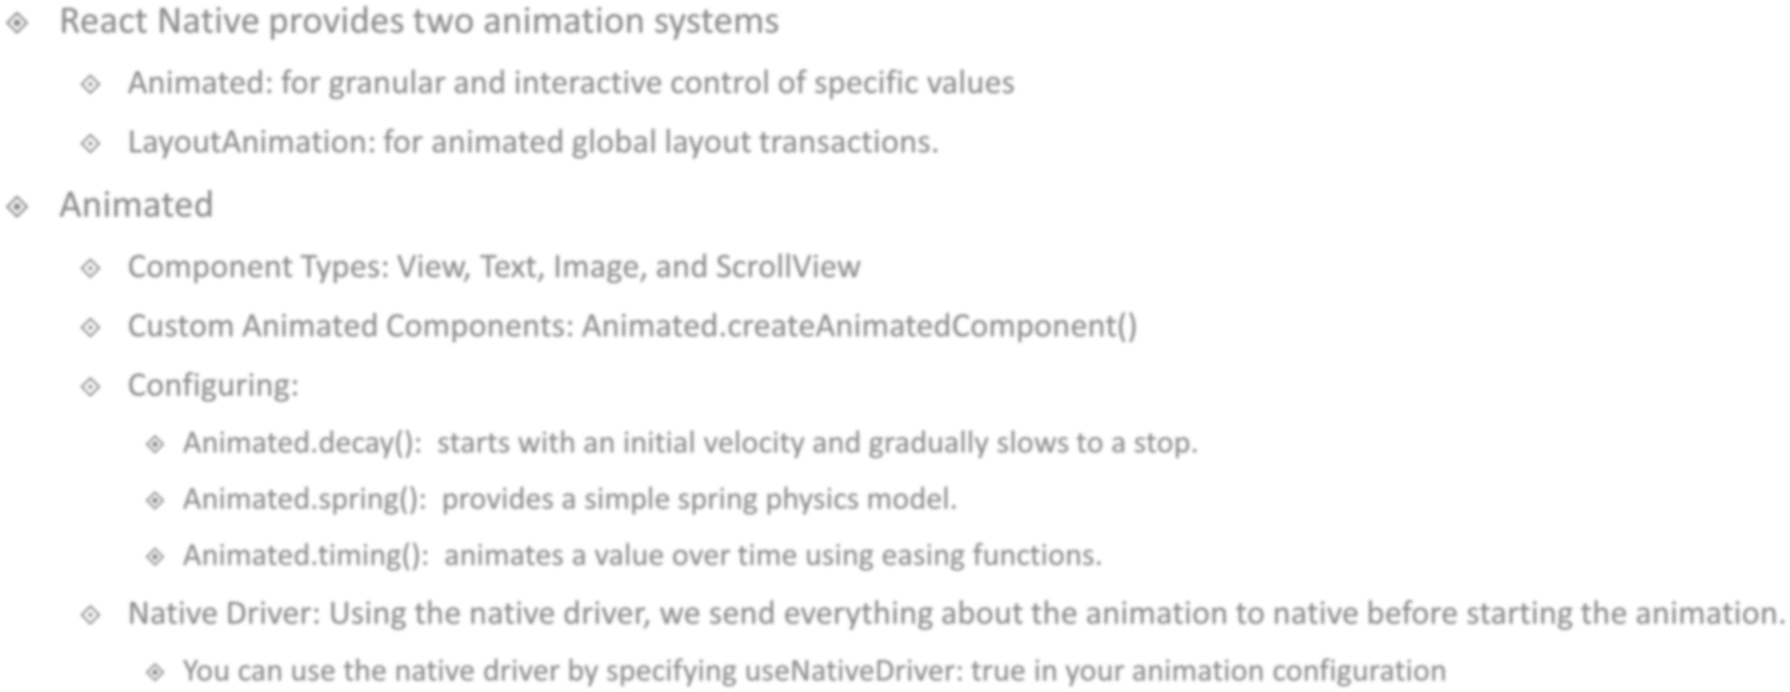





Slide 89
Publishing Applications
Android application are published to the PlayStore using the Play Store Console
IOS app are published to the AppStore using the App Store Connect.
React Native apps can be published in two main ways, depending on whether you're using Expo or a Bare (CLI) app.

Slide 90
App Build Formats
APK — Android Package
Traditional Android app install file
Used for local installation and testing
AAB — Android App Bundle
Modern publishing format required by Google Play Store
Contains all app resources; Play Store generates optimized APKs
Reduces app size for end-users
IPA — iOS App Store Package
The packaged binary for iOS apps
Can only be installed on real devices if signed properly

Slide 91
Expo publish
Expo provides a cloud-based build + publish service called EAS (Expo Application Services).
No need for Xcode or Android Studio
Expo builds the APK/AAB/IPA on the cloud
Easiest publishing method for React Native
Advantages
No native setup needed
Handles signing, certificates, device configs
Reliable + beginner friendly
OTA updates supported (Expo Updates)

Slide 92
Publishing a Bare React Native App (CLI)
Apps created using react native community cli or Expo apps that have been prebuild(ejected).
Build apps using Android Studio (Gradle) and Xcode
More control over native code

Slide 93
Publish Configuration
Permissions
Android: AndroidManifest.xml
iOS: info.plist
App Name and Identifier
Set a visible AppName, App Version and unique App identifier
Icons and Splash Screens

Slide 94
Unit Testing
Jest (Default Test Runner)
Comes preconfigured with React Native
Fast, supports mocks, snapshots, timers, spies
Great for testing JS logic, components, and utils
Testing Library for React Native(@testing-library/react-native)
Testing library built on top of React Testing Library
Helps test UI the way a user interacts
Focuses on: Text Visibility, Button Press(Touch), Input changes

Slide 95
End-to-end (E2E)
End-to-end (E2E) tests verify your app on a real device or simulator
Tools
Detox: Built specifically for React Native
Appium (Cross-Platform Automation)
Maestro (New, Lightweight E2E Tool)
BrowserStack: Cloud testing on hundreds of real devices

Slide 96
Micro-Frontends
An architecture where different parts of the UI are built and deployed independently
Each team owns a feature module (e.g., Payments, Profile, Chat)

Slide 97
Micro-Frontends Implementations
Module-based Bundles
Each feature is compiled into a separate JS bundle
Loaded into the main app via:
Metro + custom bundler config
Re.Pack (Webpack-based bundling)
Navigation-based Isolation
Each micro app exposes:
A root screen
A navigation stack
The shell app registers and mounts them dynamically

Slide 98
Micro Applications
Self-contained mini apps inside a larger React Native app
Each micro app has:
Its own screens & navigation
Its own business logic
Its own state management
Its own module boundaries
Its multiple sub-apps inside a super-app (Amazon, Paytm).

Slide 99
Thank You
ANIL JOSEPH
anil.jos@gmail.com

